Slide 1
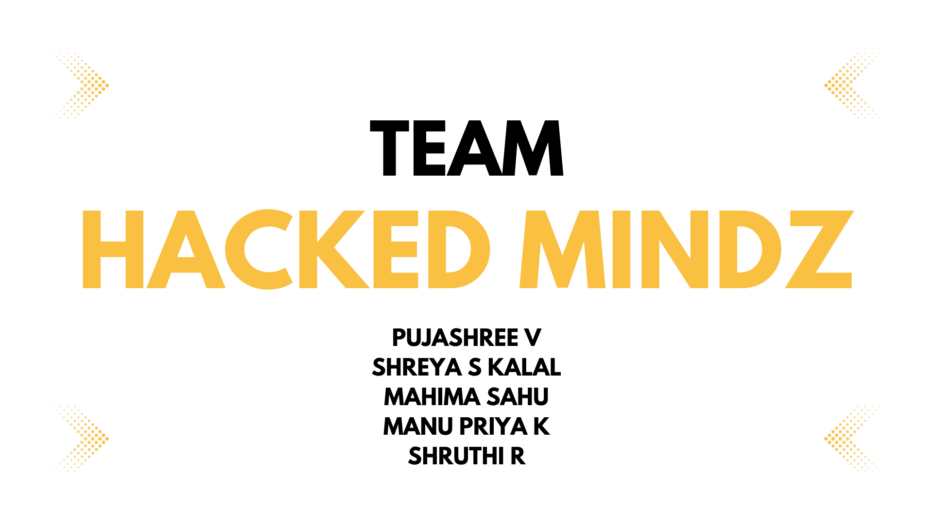
PUJASHREE V
SHREYA S KALAL
MAHIMA SAHU
MAHESH KUMAR CHAUDHARY

Slide 2
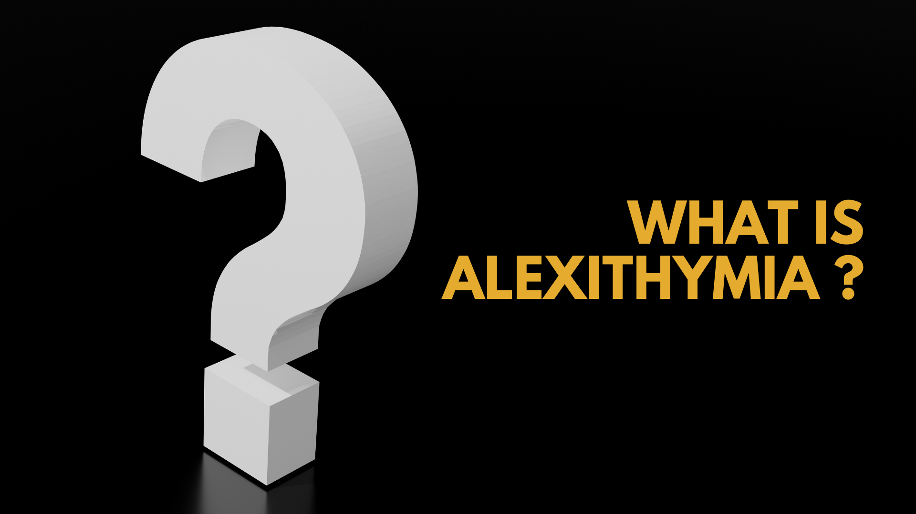

Slide 3

To make life easier for people suffering from Alexthymia.

Slide 4


Slide 5


Slide 6


Slide 7
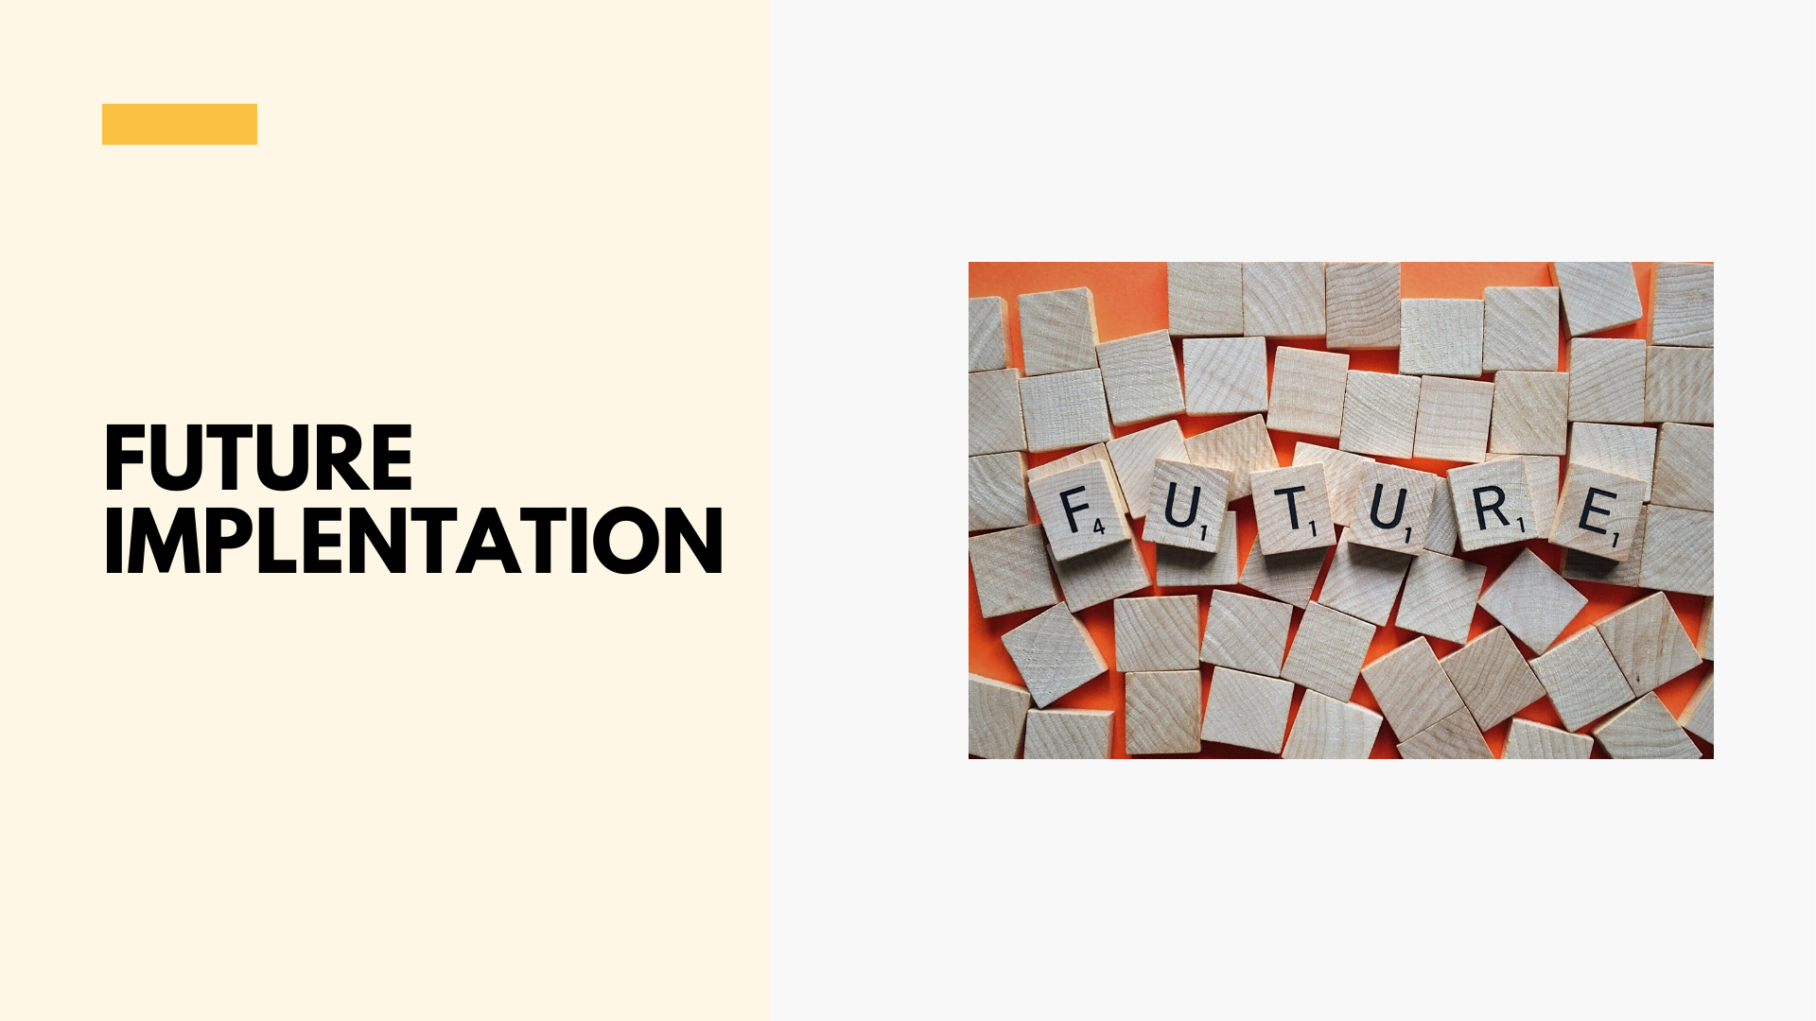
More emotions to be added
Lip reading will be an additional feature

Slide 8
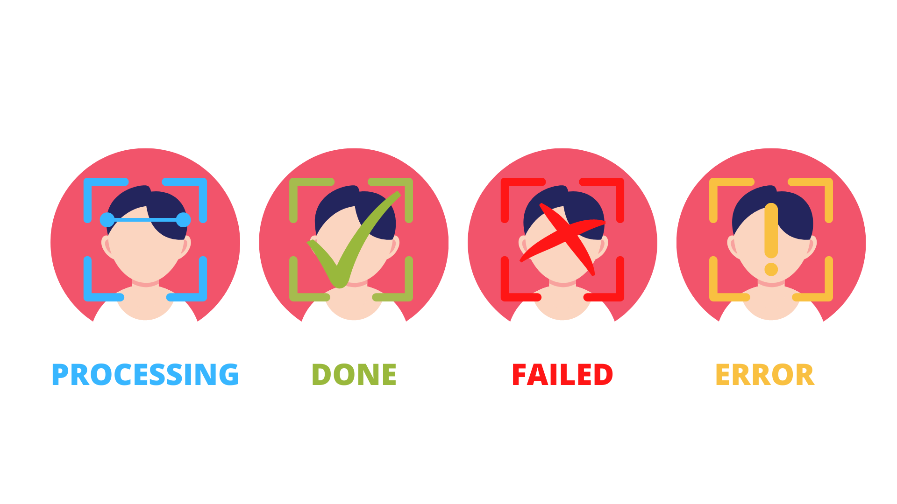

Slide 9


Slide 10


